Slide 1

Real-Time Dynamic Pricing Under Demand Uncertainty: A Hybrid Predictive-Optimization Approach
R. V. R. & J. C. College of Engineering
Department of Computer Science & Engineering (Data Science)
Batch – 10
Y. V. S. JAYANTH (Y21CD063)
D. NAGUR VALI (Y21CD016)
Under Guidance of
Mrs. N. Swathi M.Tech Assistant Professor

Slide 2
Contents
Abstract
Problem Statement
Literature Survey
Objectives
Dataset
Existing Work
Proposed Work
Results Comparison
Conclusion
References

Slide 3
Abstract
Dynamic pricing plays a pivotal role in optimizing revenue by adjusting prices according to demand. Feature engineering techniques, such as Poisson Process-based demand, and Markov Chain-based demand state transitions, are utilized. A Stacked model of LSTM-XGBoost with Random forest model is employed for demand prediction, while an optimization approach determines the most effective pricing strategy. The results demonstrate improved pricing predictions, contributing to higher revenue potential and a competitive edge.

Slide 4
Problem statement
Efficient pricing is vital in dynamic markets, as traditional static pricing strategies often result in 15–30% lower profits, with nearly 30% of businesses worldwide facing such challenges. In today’s competitive landscape, there is a pressing need for dynamic pricing systems that can adapt in real time and accurately predicting demand is needed the most which can account for stochastic nature of the world and fluctuating demad patterns.

Slide 5
Literature survey
Paper name | Problem | Methodology
[1] Dynamic Pricing Strategies for Efficient Inventory Management (2024) | Stochastic demand with dynamic pricing | Exponential Smoothing
[2] Optimizing pricing and inventory strategies for dietary supplement production under stochastic demand (2023) | Jointly optimize pricing and inventory strategies under stochastic demand in dietary supplement production. | two-stage model with demand forecasting and Piecewise Approximation Strategy (PAS)
[3] High-Dimensional Dynamic Pricing under Non-Stationarity: Learning and Earning with Change-Point Detection (2023) | Dynamic pricing in high-dimensional settings with non-stationary demand | generalized linear models

Slide 6
Literature survey
Paper name | Problem | Methodology
[4] Dynamic Pricing and Advertising with Demand Learning (2023) | Integrating dynamic pricing with advertising strategies to influence customer valuation | Reinforcement learning, simulation-based customer behavior modeling.
[5] Modeling Price Elasticity for Occupancy Prediction in Hotel Dynamic Pricing (2022) | Accurate occupancy prediction in hotel booking platforms considering price elasticity | Multi-task learning framework and deep learning model for handling data sparsity
[6] Joint dynamic pricing and inventory control with general demand functions(2020) | Solve pricing and inventory problems with non-standard demand curves | Stochastic optimization, Nonlinear programming
[7] Dynamic pricing and inventory control for multiple products under uncertain price-sensitive demand (2019) | Multi-product dynamic pricing with uncertain demand elasticity | Robust optimization, Stochastic modeling

Slide 7
Literature survey
Paper name | Problem | Methodology
[8] Inventory control and pricing with random yield and demand: A stochastic programming approach (2018) | Manage inventory when both demand and production yield are random. | Two-stage stochastic programming
[9] Dynamic pricing and inventory control in a make-to-stock system with learning (2013) | Learning customer demand distribution while jointly managing inventory and pricing | Online learning, Regret analysis
[10] Joint dynamic pricing and inventory control for multiple items under Poisson demand (2012) | Dynamic pricing + inventory management for multiple items with random demand | Approximate dynamic programming, Stochastic modeling

Slide 8
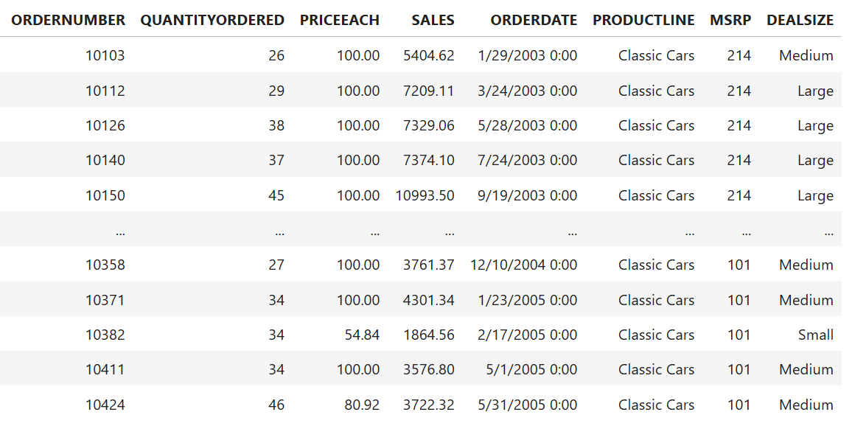
Sales Dataset
Dataset with shape : 967 rows * 8 columns Train data : 774 * 8 Test data : 193 * 8

Slide 9
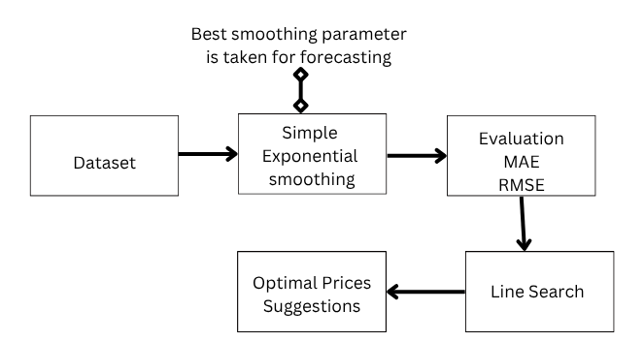
Existing method Architecture

Slide 10
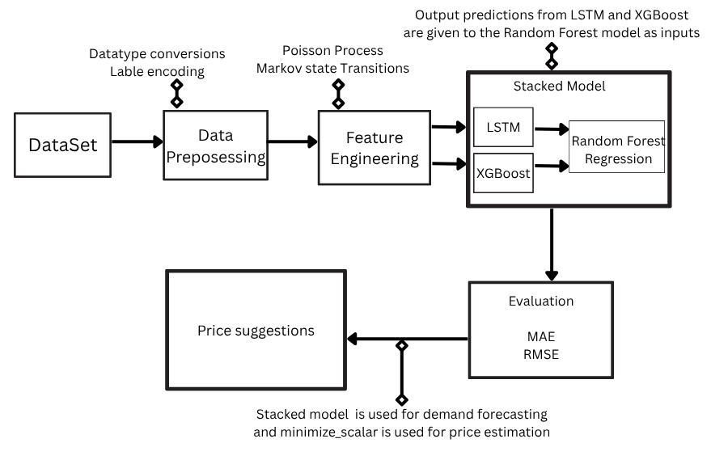
Proposed method Architecture

Slide 11
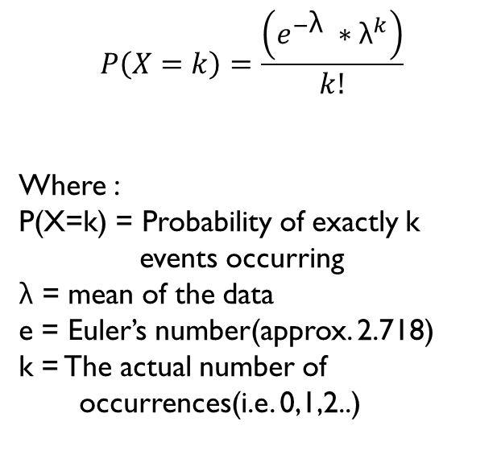
Poisson process
$$P\left(X=k\right)=\frac{\left(e^{−\text{λ}} ∗{\text{λ}}^{k}\right)}{k!}$$
$$\text{​}$$
Where :
P(X=k) = Probability of exactly k events occurring
$\text{λ}$= mean of the data
e = Euler’s number(approx. 2.718)
k = The actual number of occurrences(i.e. 0,1,2..)
Simulating sample data using Poisson (λ = 9.4 i.e mean of the Data)
Sample Data | Simulated - Sample data
10 | 11
13 | 8
6 | 7
7 | 10
11 | 10
This method introduces the stochastic nature of customer purchases by incorporating randomness into the demand modeling process.
The simulation doesn’t always give the same values; they are random in nature.

Slide 12
Markov state transition table
Next State
 | Small | Medium | Large
Small | 0.88428571 | 0.10428571 | 0.01142857
Medium | 0.04739961 | 0.92955892 | 0.02304147
Large | 0.01428571 | 0.04714286 | 0.93857143
Current State
The values represent the probabilities of transitioning from the current state to a subsequent state.
The values are obtained by observing the previous transitions in the data.

Slide 13
Results
Method | MAE | RMSE | Accuracy(%)
Existing Method | 11.27 | 14.56 | 83.26
XGBoost | 9.46 | 12.55 | 85.57
Support Vector Regression | 9.35 | 12.65 | 85.45
LSTM | 9.15 | 12.43 | 85.81
Random Forest | 10.07 | 13.78 | 84.15
Gradient Boosting | 11.49 | 15.35 | 82.36
Proposed Method | 3.05 | 4.49 | 92.95

Slide 14
conclusion
Dynamic pricing benefits from models that adapt to demand, competition, and external factors. A stacked LSTM–XGBoost model with Random Forest has shown strong performance in predicting demand by capturing temporal trends and complex feature interactions. Key enhancements include, Poisson-based demand modeling, and Markov Chain demand state transitions. Optimized pricing strategies derived from the model lead to improved revenue and a stronger competitive position. Future improvements may include finer market signals and advanced optimization techniques.

Slide 15
reference
[1] https://www.sciencedirect.com/science/article/pii/S2666720724000626
[2]https://www.researchgate.net/publication/371693924_Optimizing_pricing_and_inventory_strategies_for_dietary_supplement_production_under_stochastic_demand
[3] https://arxiv.org/abs/2303.07570
[4] https://arxiv.org/abs/2304.14385
[5] https://arxiv.org/abs/2208.03135
[6] https://pubsonline.informs.org/doi/10.1287/opre.2020.1993
[7] https://www.sciencedirect.com/science/article/abs/pii/S036083522300089X
[8] https://onlinelibrary.wiley.com/doi/full/10.1111/poms.13706
[9] https://pubsonline.informs.org/doi/10.1287/opre.1090.0718
[10] https://papers.ssrn.com/sol3/papers.cfm?abstract_id=2402531

Slide 16
Thank you

